Slide 1
Math Examples

Slide 2
Classroom Examples: Table of Contents
4th grade, Composite numbers
5th grade, Common Core word problem
High School, Algebra I, Expressions & equations
High school, Algebra II & III, Types of graphs
High school, Geometry, Scale factor
High school, Geometry, Equations
High School, Algebra I, Quadratics
High School, Algebra I, Number Systems
High School, Statistics, PBL: statistical research
QFocus ideas
Engaging hooks
Integers
Decimals, fractions, & exponents
Factoring, statistics, & word problems

Slide 3
Classroom Example: 4th Grade
Teacher: Alyssa Park, Gardnerville, NV
Topic: Composite Numbers
Purpose: To build number awareness skills and practice a strategy for difficult multiplication problems
Back to Table of Contents

Slide 4
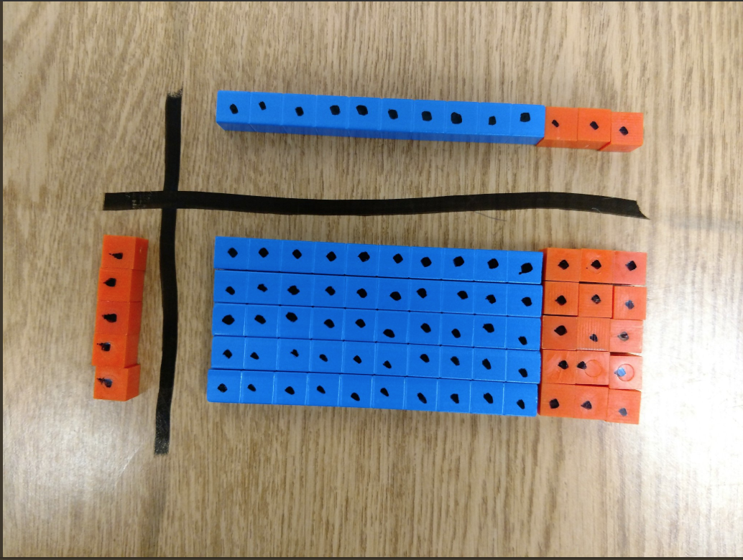
Question Focus
Image Source: https://twitter.com/MissParkSES/status/927373487412412417

Slide 5
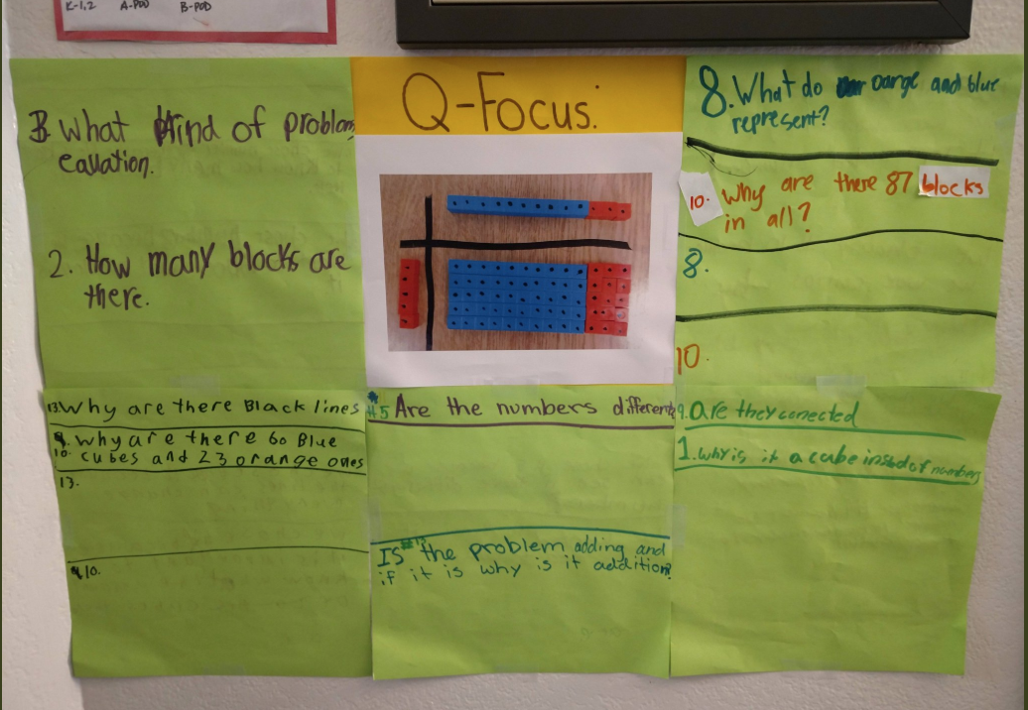
Student Questions
How many blocks are there?
Why are there black lines?
Why are there 60 blue cubes and 23 orange ones?
Is the problem adding and if it is why is it addition?
What do orange and blue represent?
Are they connected?
Why is it a cube instead of numbers?

Slide 6
Classroom Example: 5th Grade
Teacher: Deirdre Brotherson, Hookset, NH
Topic: Common Core Math Problem
Purpose: To develop critical thinking skills in preparation for problem-solving and state testing
Back to Table of Contents

Slide 7
Question Focus
A Common Core Word Problem

Slide 8
Student Questions
Initial Questions
What are we supposed to do?
Why are all the answers the same?
What does “down” mean?
Why do some have -30?
What do the ( ) and [ ] mean?
Do we -30 or +30?
7. What is a discount?
8. What is ½ of a balance?
9. What is a balance?

Slide 9
Student Questions
Questions Post-Vocabulary Discussion
Do we look at the problems with only -30?
Do we cross out +30 problems?
Do we do 110 + 30 first?
If we do 110 + 30 that is the amount he put down and the discount, right?
So that means we take that away from the total $350, right?
So the ( ) mean we do that first but how do we subtract that from 350 then divide by half?
Is that what the [ ] means?

Slide 10
Classroom Example: Algebra I
Teacher: Jessica Brewer, Booneville, KY
Topic: Expressions & Equations
Purpose: To uncover students’ prior knowledge and develop essential questions
Back to Table of Contents

Slide 11
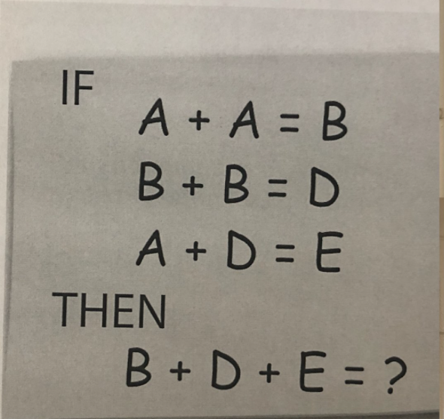
Question Focus
Image Source: https://twitter.com/jessicabrewer04/status/1033062227383906310

Slide 12
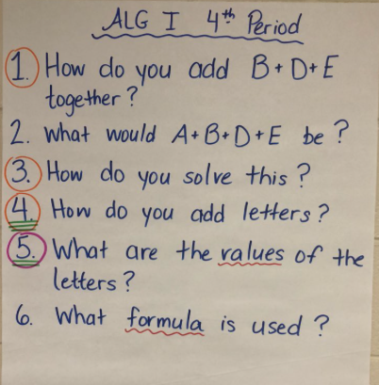
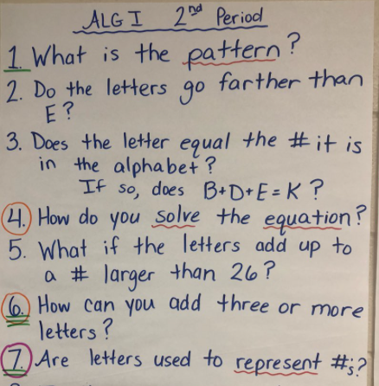
Student Questions
What is the pattern?
Do the letters go farther than E?
Does the letter equal the # it is in the alphabet?
If so, does B + D + E = K?
How do you solve the equation?
What if the letters add up to a # larger than 26?
How can you add three or more letters?
Are the letters used to represent #’s?
How do you add B + D + E together? What would A + B + D+ E be?
How do you solve this?
How do you add letters?
What are the values of the letters? What formula is used?

Slide 13
Classroom Example: Algebra II & III
Teacher: Jessica Brewer, Booneville, KY
Topic: Graphing
Purpose: To discover different types of graphs and practice describing them
Back to Table of Contents

Slide 14
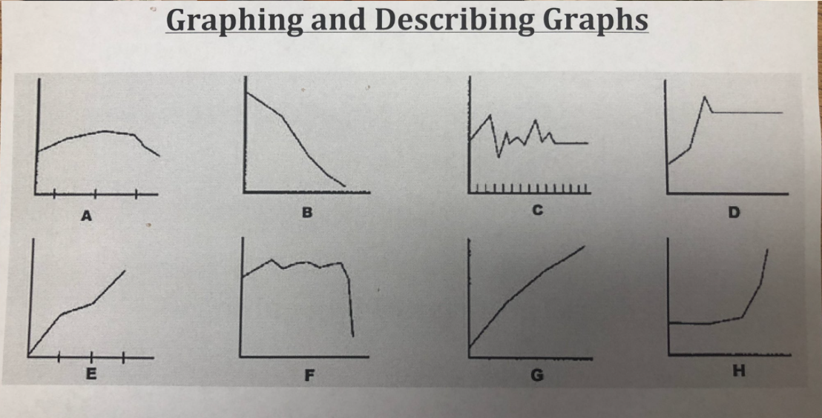
Question Focus
Image Source: https://twitter.com/jessicabrewer04/status/1033062227383906310

Slide 15
Student Questions
Algebra II:
Why do some graphs have “notches”?
Why are there huge falls?
How do you determine the slope in graph C?
How do you determine if slope is increasing or decreasing?
Is graph A linear? If so, how?
Why is graph D going up?
What are the graphs based off of?
How do you know what to graph?
What are the graphs describing?
Where are the points located if they were plotted?
What do these graphs have to do with the QFT?
How do you describe a graph?
What were the graphs for?
What are the slopes of the graphs?
Why does graph F look so “sad”?
Why do all the lines look so different?
How do you know where to plot?
How is this important?
Why are they labelled A, B, C, D?
Algebra III:
Why do some graphs have tick marks?
What do the graphs represent?
How can graphs help gather evidence?
Why does graph C fluctuate so much?
Why does graph D increase, decrease, then stay steady?
What is unique to each graph?

Slide 16
Classroom Example: High School
Teacher: Laura Barzottini, Cape Town, South Africa
Topic: Geometry
Purpose: To introduce the concept of transforming shapes using a scale factor
Back to Table of Contents

Slide 17
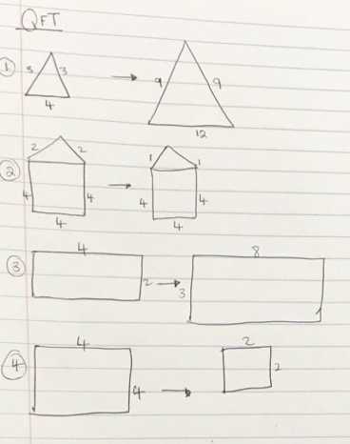
Question Focus

Slide 18
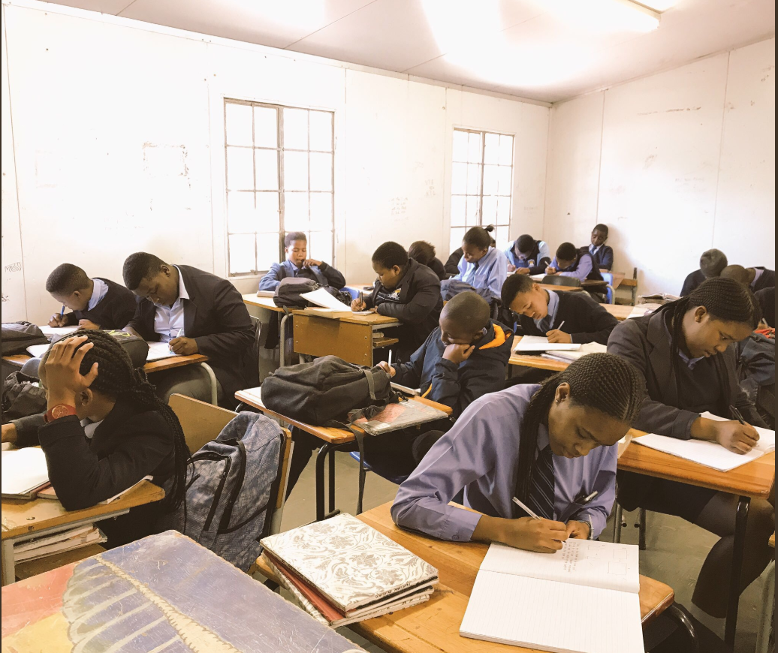
Student Questions
Why are these 2 triangulars not the same and why are the numbers not the same?
Why are these shape the same and numbers are not the same?
Why is the other rectangular small and the other is big?
Why the cubes only have 2 numbers only?
Are the shapes similar or congruent?
Why are some small and some big?
Are first shapes reflections?

Slide 19
Classroom Example: High School
Teacher: George Marenco, Sacramento, CA
Topic: Geometry
Purpose: To develop essential questions for the unit on equations
Back to Table of Contents

Slide 20
Question Focus
Equation = Balance

Slide 21
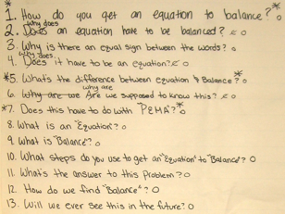
Student Questions
How do you get an equation to balance?
Why does an equation have to be balanced?
Why does it have to be an equation?
What’s the difference between equation and balance?
Why are we supposed to know this?
Does this have to do with “PEMA”?
Why is there an equal sign between the words?
Does it have to be an equation?
Are we supposed to know this?
What is an equation?
What is balance?
What steps do you use to get an “equation” to “balance”?
How do we find balance?
What’s the answer to this problem?
Will we ever see this in the future?

Slide 22
Classroom Example:
High School
Teacher: Rick Barlow, San Jose, CA
Topic: Algebra 1: Quadratics
Purpose: To introduce the quadratics unit by having students explore modelling data with a function.
Back to Table of Contents

Slide 23
Before the Question Focus
8
Square Size | # of Bingo Chips that Fit
2
3
4
6
8
8
3
3
6
6

Slide 24
Question Focus
The function that best models this data
Square Size | # of Bingo Chips that Fit
2
3
4
6
8

Slide 25
Student Questions
Is this related to polynomial?
What would you call a function that is neither linear or exponential?
Will this graph give us the exact # of how many chips will fit in the square?
Does size of chips matter?
Can it be exponential on a graph and not on a table?
Why is the line on the graph curved and then out of nowhere it goes straight?
How could you find what the table is multiplying by?
Why does it increase rapidly then slow down?
What would the slope look like?
What type of function is the graph if it is not a J, L, or linear?
If we were to find the amount of chips found in an 11 in a square could we double that and find the answer for a 22 inch square?
Does the graph cross zero?
What kind of math did people use to get these solutions?

Slide 26
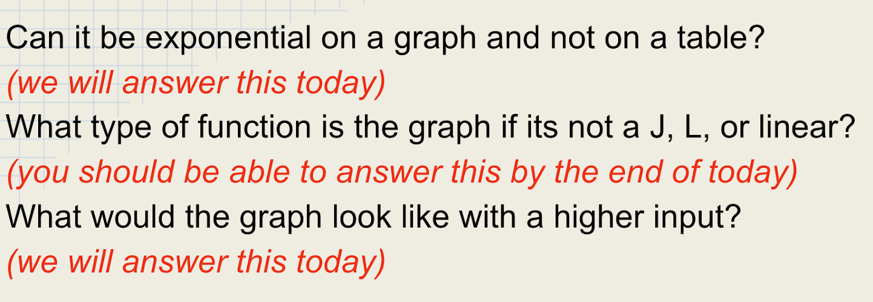
Next Steps with Student Questions
Questions used as opening slides for the next day’s lesson
Revisited at the end as a debrief

Slide 27
Classroom Example: High School
Teacher: Rick Barlow, San Jose, CA
Topic: Number Systems
Purpose: To engage students on the first day of school; to practice backward reasoning and problem-solving skills
Back to Table of Contents

Slide 28
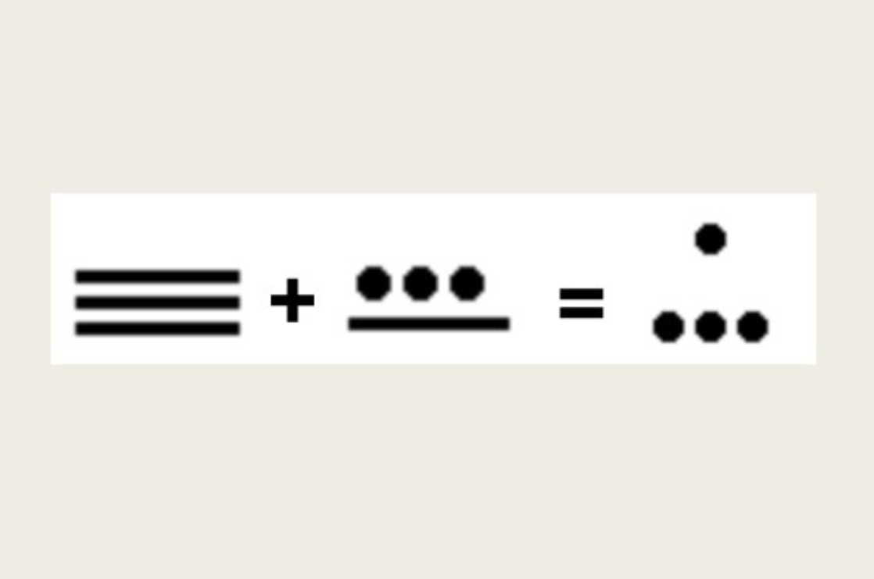
Question Focus

Slide 29
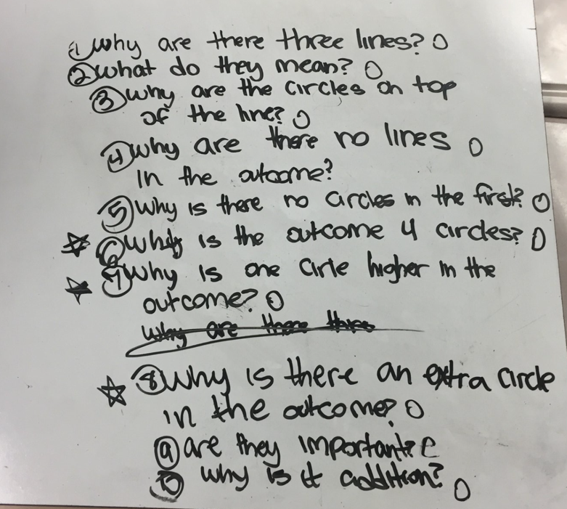
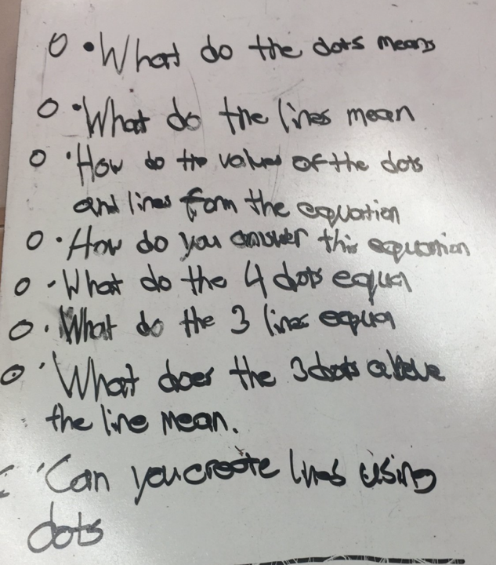
Student Questions
What do the dots means?
What do the lines mean?
How do the values of the dots and lines form the equation?
How do you answer this equation?
Can you create lines using dots?
Why are the circles on top of the line?
Why are there no lines in the outcome?
Why is the outcome 4 circles?
Are they important?
Why is one circle higher in the outcome?

Slide 30
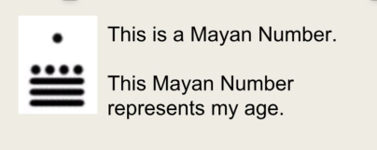
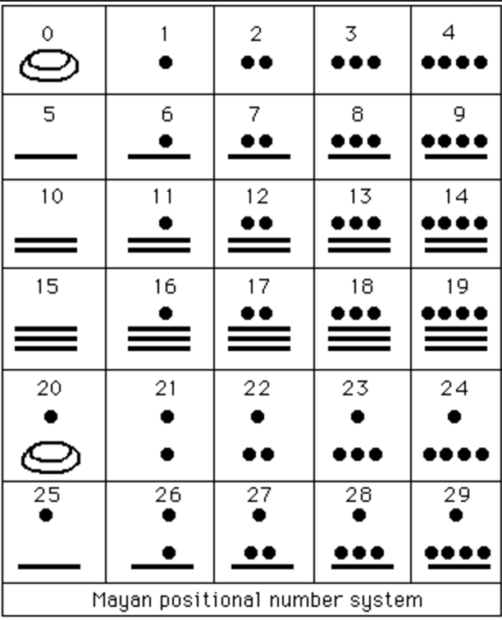
Next Steps with Student Questions
Students thought of numbers that would be too high and too low for the teacher’s age.
Students used the ideas generated by their questions to guess the teacher’s age.
Teacher revealed the code.

Slide 31
Classroom Example: High School
Teacher: Rick Barlow, San Jose, CA
Topic: Immigration Statistics PBL
Purpose: To produce questions for statistical research
Back to Table of Contents

Slide 32
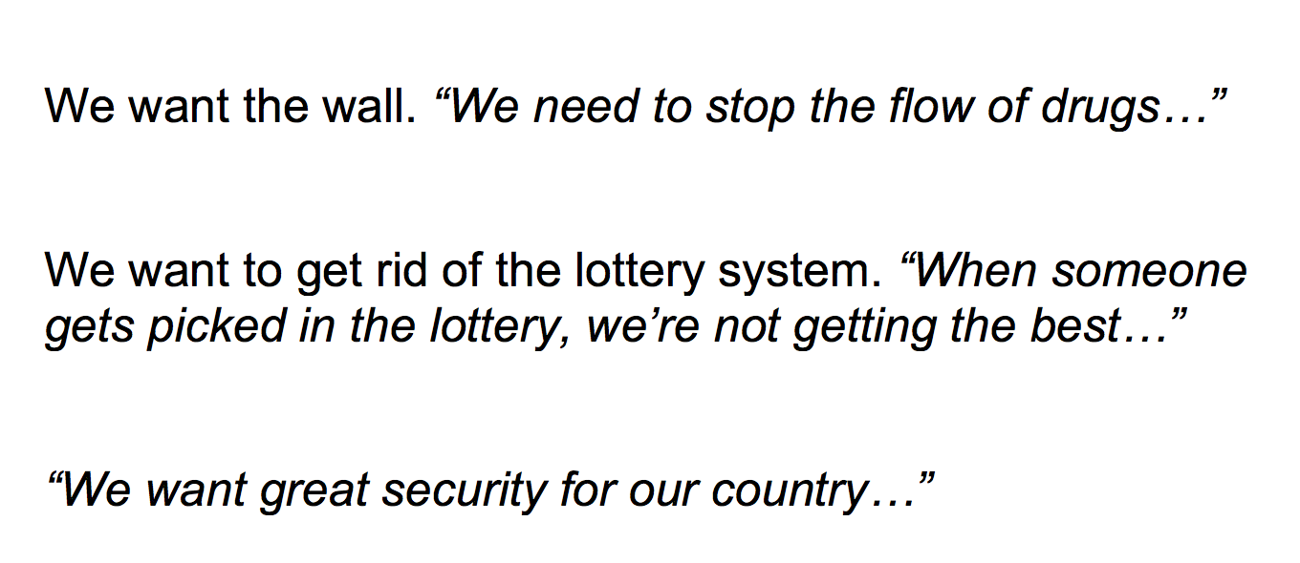
Question Focus
3 claims about immigration pulled from a campaign speech video

Slide 33
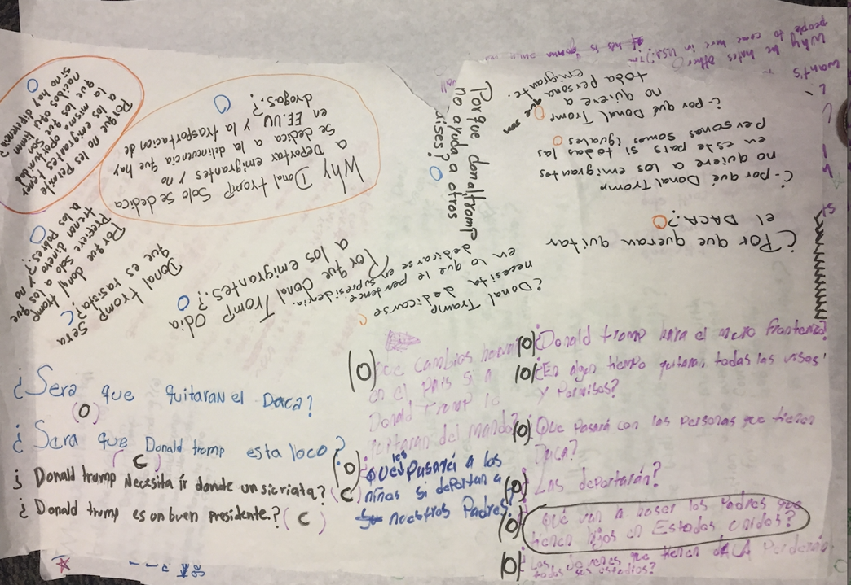
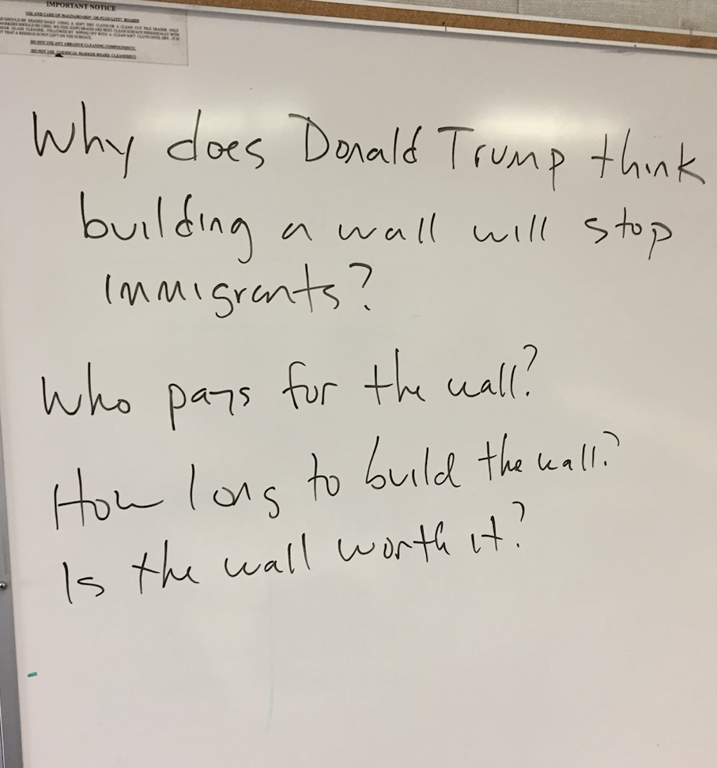
Next Steps with Student Questions
Ss categorize questions as groups share: DACA, the wall, security, drugs/crime
Ss’ preferences of the 4 big topics used to create groups
Groups craft “claim” about topic counter to the president’s claim
Ss support their claim using statistical research

Slide 34
For more information on Rick Barlow’s lesson
ELL Students Use Statistics to Challenge Immigration Claims
http://kindlingfires.blogspot.com/2018/01/immigration-project-launch.html
If you search the blog, you’ll find several of Rick’s QFT lessons with all levels of students—from ELL immersion classes to AP classes.

Slide 35
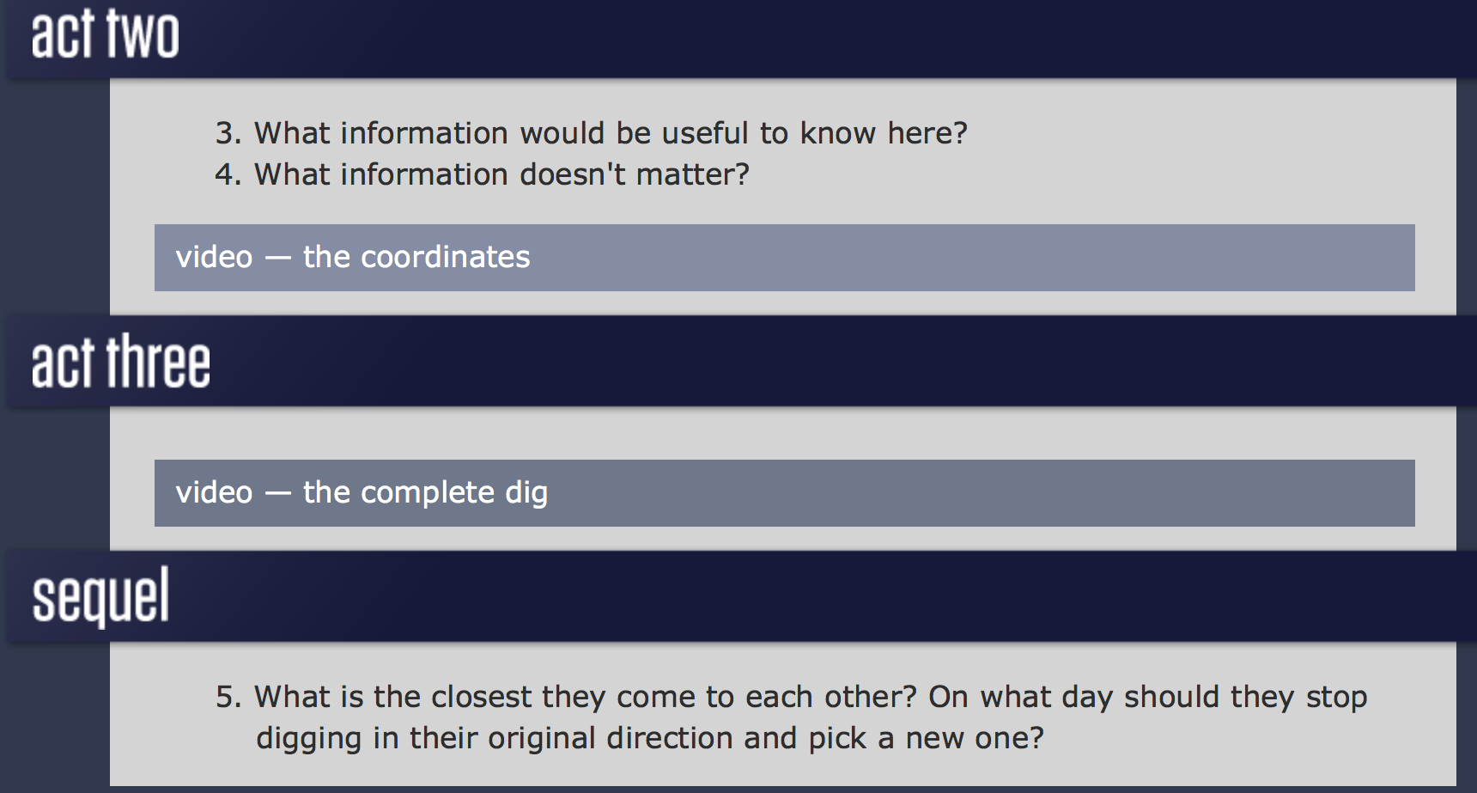
Even More Math QFT Ideas
In the following slides, we’ve collected examples of interesting math QFocus prompts that do not have the full classroom application.
Dan Meyer’s 3-Act Math Problems
TapIntoTeenMinds.com
A picture of three Macy’s certificates: One card that offers 15% off on a purchase, another that offers 20% off on one item, and another that offers $25 on purchases over $100. (or some other combination)
Back to Table of Contents

Slide 36
Even More Math QFT Ideas
Working with Integers
“Broken-Egg Problem”
“...When she put the eggs in groups of two, three, four, five, and six, there was one egg left over, but when she put them in groups of seven they ended up in complete groups with no eggs left over.”
What number leaves a remainder of 4 when divided by 7, 5 when divided by 8, and 6 when divided by 9?

Slide 37
Even More Math QFT Ideas
Decimals, Fractions, Exponents
⅕ = 0.20
0.28
X⁰ = 1
2/10
8/100

Slide 38
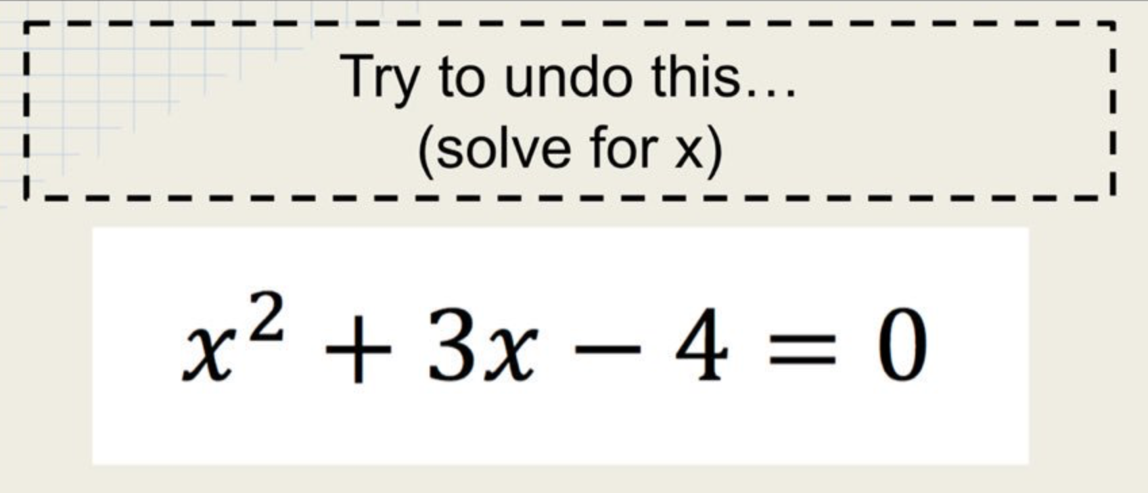
Even More Math QFT Ideas
Quadratics, Word Problems, Statistics, Data
Impossible to solve→ Introducing the need for factoring to solve quadratics
Statistics always tell the truth
Give a relatively simple problem to solve→ QFT on the answer→ Each student takes one question to individually work on further→ Present solutions, pick one, and repeat the process
Correlation implies causation

